Slide 1
Topic modeling primer
Richard Haans
haans@rsm.nl
April 29 2022

Slide 2
Agenda
What is topic modeling?
How to do topic modeling?
Publishing with topic models

Slide 3
What is it?

Slide 4
Text analysis in strategic management
Many organizational phenomena play out or are represented in written and spoken word.
Annual reports
Patents
Scientific publications
Press releases
Policy documents
Newspaper articles
Etc.
Automated text analysis allows us to move from words to numbers and generate data that can be used in quantitative descriptive analysis or regression analysis.

Slide 5
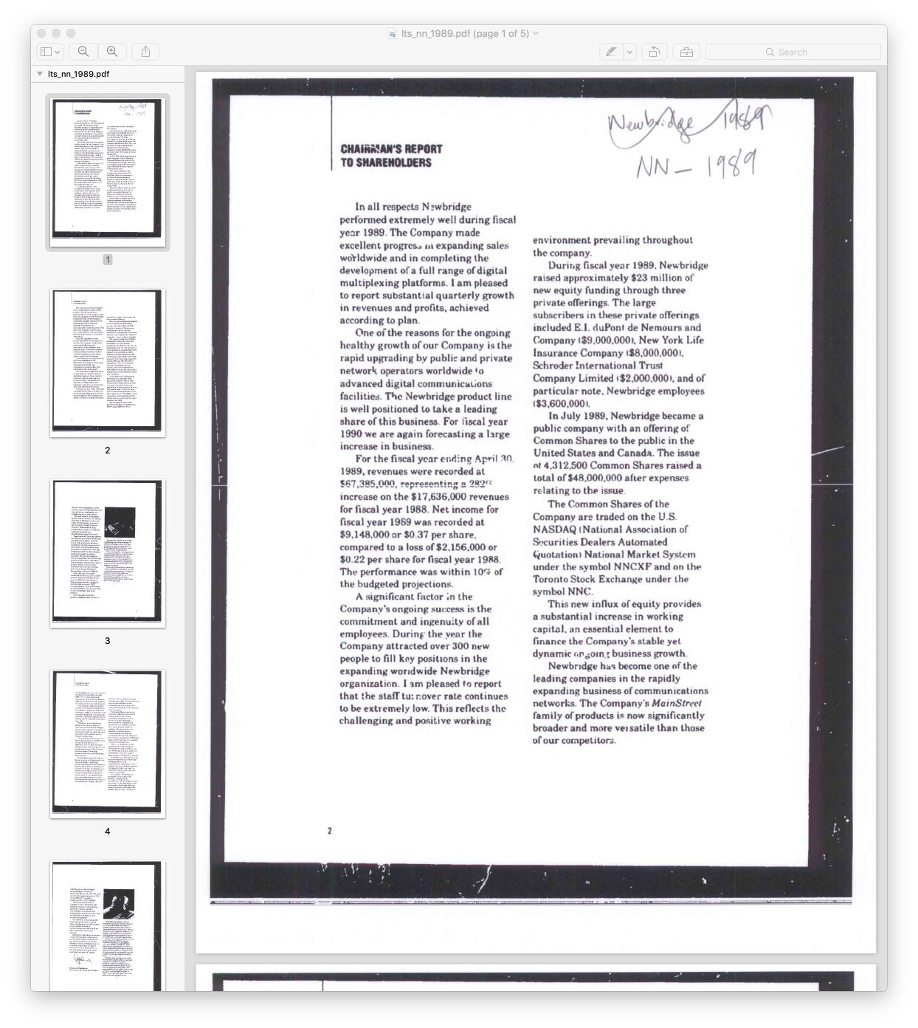
Text analysis in strategic management
Historically, huge costs of analyzing collections of texts have limited progress.
Promise of automated text analysis (e.g. topic modeling):
Cost/time reduction.
Reduction (in some ways) of human intervention.
Systematic nature fosters replicability.
Enables us “to take the measure of large-scale social phenomena that we could not have previously been able to do” (Mohr et al., 2013).

Slide 6
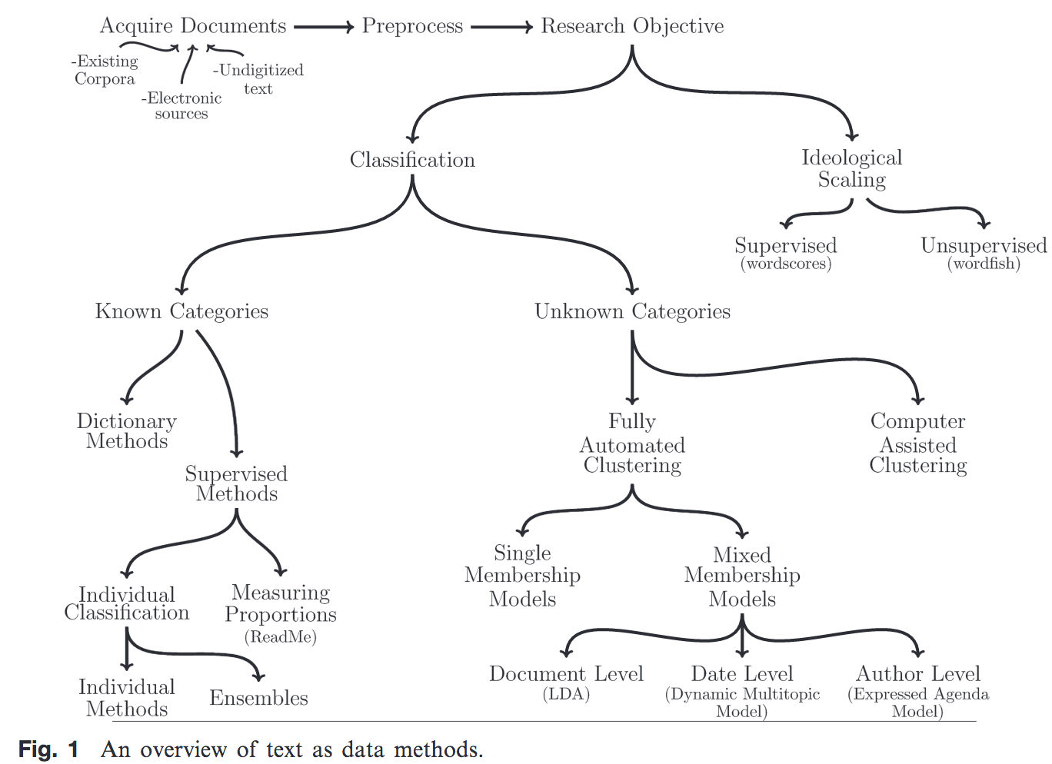
Source: Grimmer and Stewart (2013) Political Analysis

Slide 7
Topic modeling
In classic content analysis (Lasswell et al., 1952), the “goal was to find ways to measure ideas which were latent constructs indexed by constellations of word symbols”.
Topic models find short descriptions of the members of a collection of texts that enable efficient processing while preserving the essential statistical relationships useful for basic tasks such as classification, novelty detection, summarization, and similarity and relevance judgments (Blei, Ng, and Jordan, 2003).
Increasingly used in strategic management research (e.g., Kaplan & Vakili, 2015; Haans, 2019, see Hannigan et al., 2019 for a review).

Slide 8
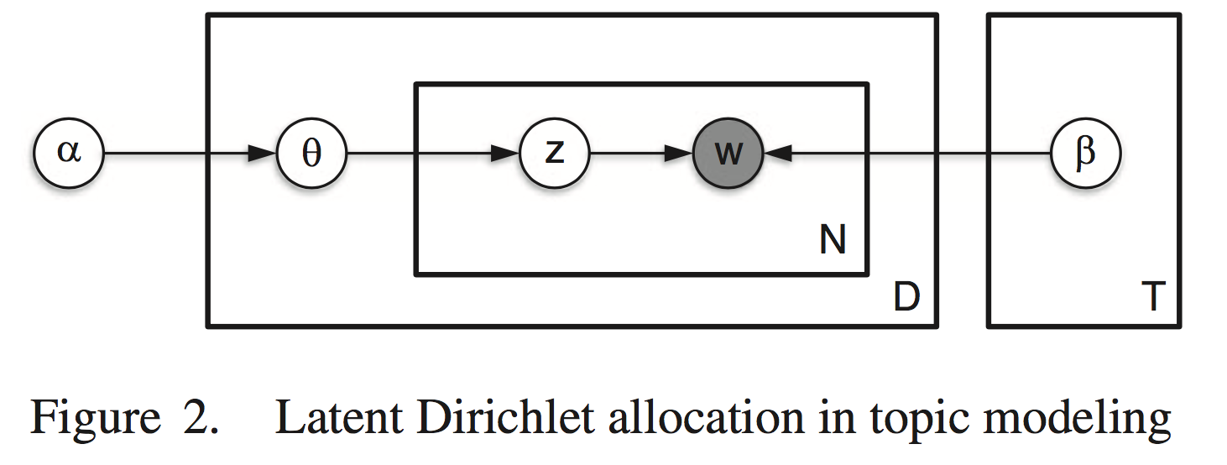
Topic modeling
Key features:
“Bag of words” – no syntax.
Best for identifying themes where categories are unknown.
“Unsupervised” text analysis.
Key outputs:
Topics: clusters of co-occurring words (“word constellations”, Mohr et al., 2013).
Term loadings (per topic).
Topic loadings (per document).

Slide 9
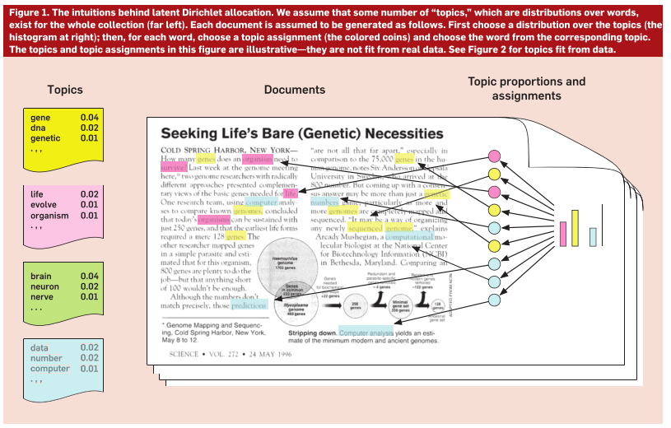

Slide 10
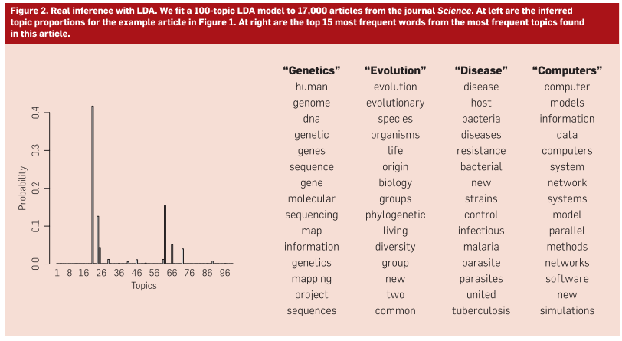

Slide 11
But:
Topic modeling is becoming “black boxed” in social science.
Sensitive to inputs to the algorithm.
Often requires more “supervised” approaches to create semantically meaningful results.
“Best fit” for computer scientists very different from “best fit” for social scientists.
Automation does not replace deep understanding of the texts. It requires context-specific validation (see e.g. Kaplan & Vakili, 2015):
Hand-coding by researcher.
Expert coding and validation.
Interviews.
Validation involves “interpretive uncertainty” (DiMaggio, 2015).

Slide 12
Principles
Four principles from Grimmer and Stewart (2013):
All quantitative models of language are wrong but some are useful.
Quantitative methods augment humans, but do not replace them.
There is no one “best” method for automated text analysis.
Validate, validate, validate.

Slide 13
How to do it?

Slide 14
The rendering process
Rendering corpora
Rendering topics
Rendering theoretical artifacts
Selecting
Trimming
Applying algorithms
Fitting
Creating
Building with
Rendering is a process of generating provisional knowledge by iterating between selecting and trimming raw textual data, applying algorithms and fitting criteria to surface topics, and creating and building with theoretical artifacts, such as processes, causal links or measures. (Hannigan, Haans, Vakili, Tchalian, Glaser, Wang, Kaplan & Jennings, 2019)
We can think about this as a processing/analysis pipeline where the analyst can make modifications iteratively.

Slide 15
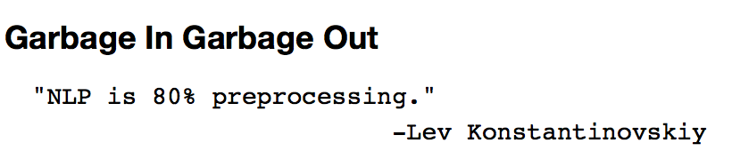
Rendering corpora
Rendering theoretical artifacts
Rendering corpora
Rendering topics
Selecting
Trimming
Applying algorithms
Fitting
Creating
Building with
Computer scientists employing topic modeling have long recognized the need for preprocessing texts.
This process is full of theoretical and methodological assumptions, each with implications for the work involved.
There is no set standard for preprocessing all texts—requires thoughtful engagement with the data.
Python Gensim community manager

Slide 16
Rendering corpora
Rendering theoretical artifacts
Rendering corpora
Rendering topics
Selecting
Trimming
Applying algorithms
Fitting
Creating
Building with
Selecting textual data:
Which texts to include in the corpus? Need to account for language, authoring, document sources.
Trimming textual data:
Shaping it into a corpus.
Linguistic processing techniques such as:
Removing stopwords.
Transforming/standardizing words through stemming.
Lemmatizing (ie. converting to singular forms, or to high-level synonyms through a linguistic thesaurus such as WordNet).
Conjoining words into meaningful phrases / n-grams.
Removing (in)frequent terms.

Slide 17
Rendering corpora: Illustration
See https://github.com/RFJHaans/SMS_2022_topicmodeling for full data and code.
Selecting the data: Texts from websites of biopharma firms in 2020 (in Compustat). 318 websites, total. Grabbed frontpages + one link deeper.
Why websites? To capture strategic positioning, e.g. Haans (2019).
Why biopharma? No clear reason.
Why firms in Compustat? List of websites; link to financials.
Why 2020? No clear reason.
Consider selection ramifications of these choices.

Slide 18
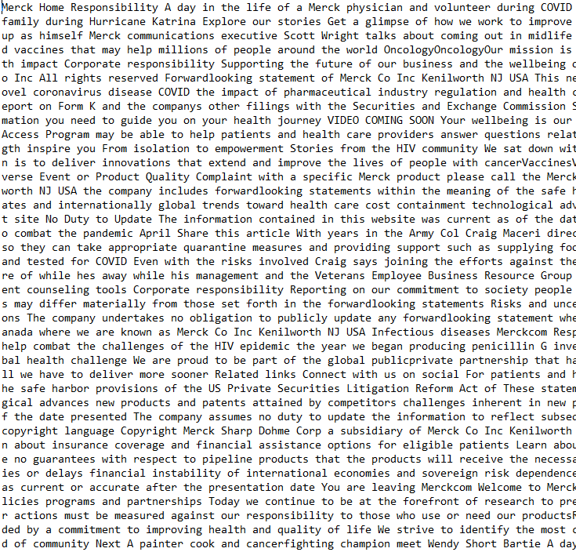


Slide 19
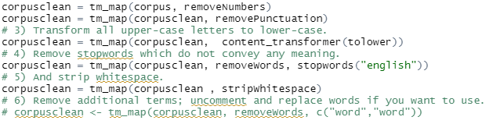
Rendering corpora: Illustration
Trimming data:
Basic cleaning: remove numbers, punctuation, make lower-case, remove stop words, strip whitespace.
No other cleaning. Results in 108,866 unique terms; max term length = 4464.
Considerations:
Stop word list in R is different from e.g. NLTK in Python. Implications?
Due to working with HTML and unstructured nature of websites a lot of junk / highly unique terms in the data—remove?
Most websites contain boilerplate texts (e.g. cookies)—remove?
Other terms?

Slide 20


Slide 21
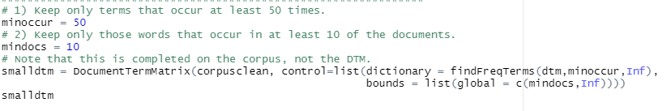
Rendering corpora: Illustration
Trimming data:
Basic cleaning: remove numbers, punctuation, make lower-case, remove stop words, strip whitespace.
Removing terms that occur in fewer than 10 documents or less than 50 times. Results in 6,279 unique terms; max term length = 43.

Slide 22
Rendering topics
Rendering theoretical artifacts
Rendering corpora
Rendering topics
Selecting
Trimming
Applying algorithms
Fitting
Creating
Building with
Applying algorithms:
Basic algorithm for topic modeling: Latent Dirichlet Allocation (LDA). Others exist: correlated topic models and structural topic models becoming more popular.
Configurations: number of topics, various settings specific to algorithm.
Fitting:
Quantitative measures of fit (e.g. semantic coherence, exclusivity, held-out likelihood).
But also: validity—are the topics meaningful?

Slide 23
Rendering topics: Illustration
Applying algorithms:
Correlated topic model—relaxes the assumption that topics are uncorrelated and leads to better quality models (Blei & Lafferty, 2007).
Additional benefit: the stm package in R estimates this by default and is an extremely user-friendly implementation.
Considerations:
What are the settings / choices of parameter?
Number of topics.
Initialization method; e.g. LDA, Spectral... Spectral is advised (Roberts, Stewart and Tingley, 2016).
Random seed (I always use 123456789).
See documentation for command for full list; other choices when using LDA.

Slide 24
Rendering topics: Illustration
Fitting:
Key choice when using a CTM (and most topic models) is the number of topics. Few hard rules, some guidelines, e.g. Lindstedt (2019:311):
"For shorter, focused corpora (i.e., those ranging from a few hundred to a few thousand documents in size), an initial choice between five and 50 topics is best, whereas for larger, unfocused corpora (i.e., those ranging from tens of thousands to hundreds of thousands of documents in size or larger), previous research has found that between 60 and 100 topics are best (Roberts et al. 2018)."
Considerations:
How to determine the best choice from these ranges? Which fit statistics to focus on?

Slide 25
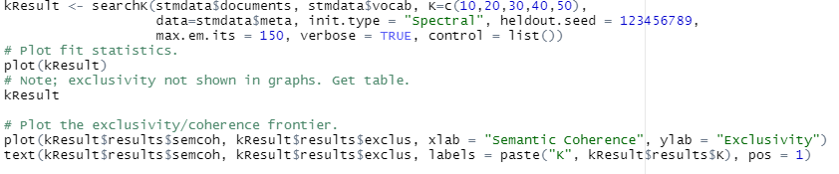
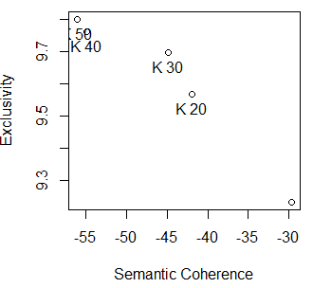
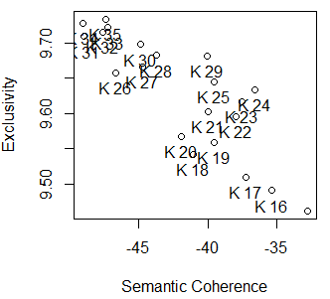
Rendering topics: Illustration
Fitting:
Recent work tends to focus on “exclusivity”—whether or not terms with high probabilities in one topic have low probabilities under other topics— and “semantic coherence”—whether topics are internally consistent.
Alternative metrics exist, but do not tend to map onto interests of social scientists as well (i.e., more substantive meaning rather than statistical fit).
24 seems best; perhaps 29.
Substantive validation needed.

Slide 26


Slide 27
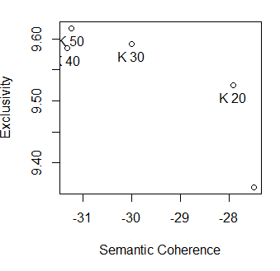
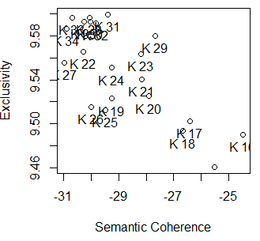
Rendering topics: Illustration
With smaller DTM:
Still in the 20-30 range.
24 no longer the best number; 29 or 17 seems better.

Slide 28
Rendering artifacts
Rendering theoretical artifacts
Rendering corpora
Rendering topics
Selecting
Trimming
Applying algorithms
Fitting
Creating
Building with
Once topic model has been curated and tuned, theoretical artifacts (Whetten, 1989) can be created and can used in theory building and testing.
Two key outputs:
Terms per topic (with weights).
Topics per document (with weights).
How you use / interpret these depends crucially on your RQ. This is where the fun really begins.

Slide 29
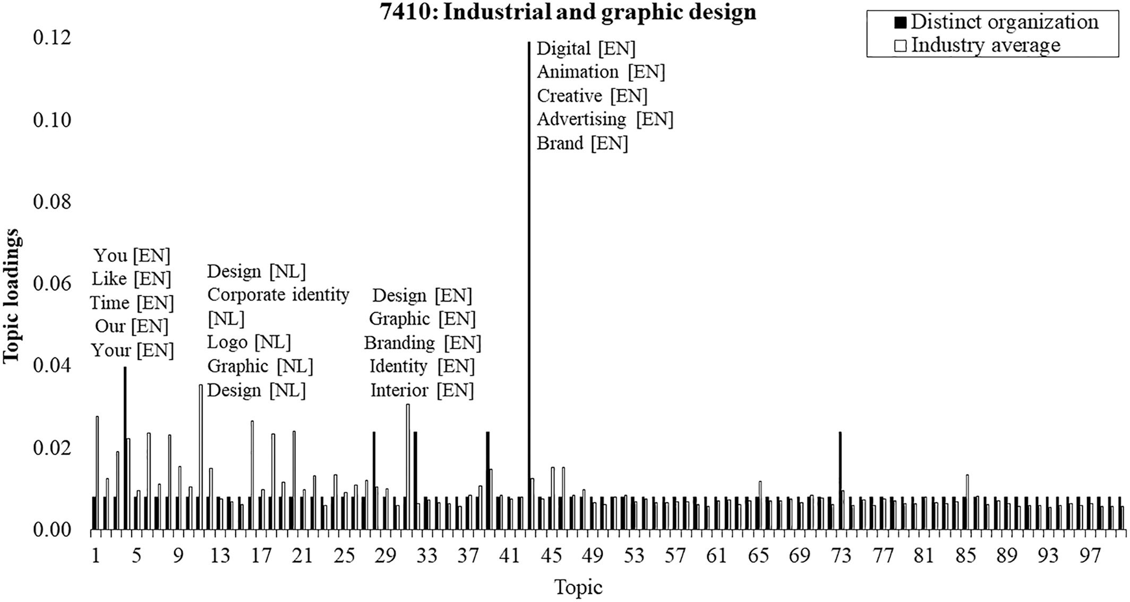

Slide 30

Rendering artifacts: Illustration

Slide 31
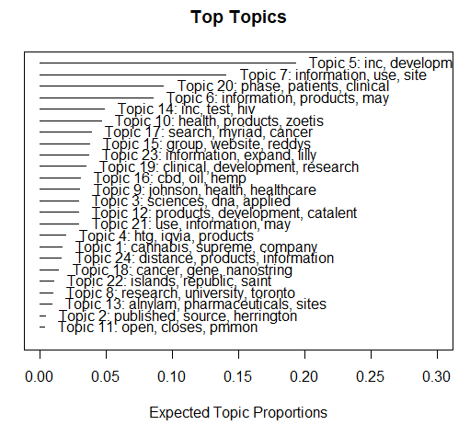
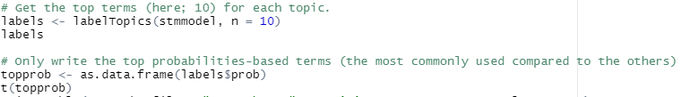
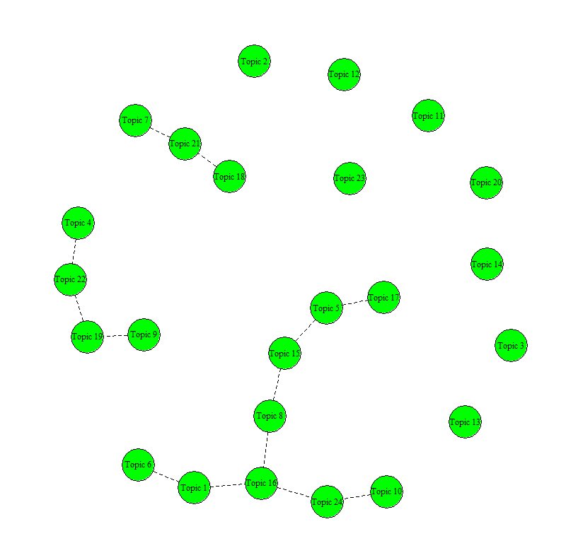
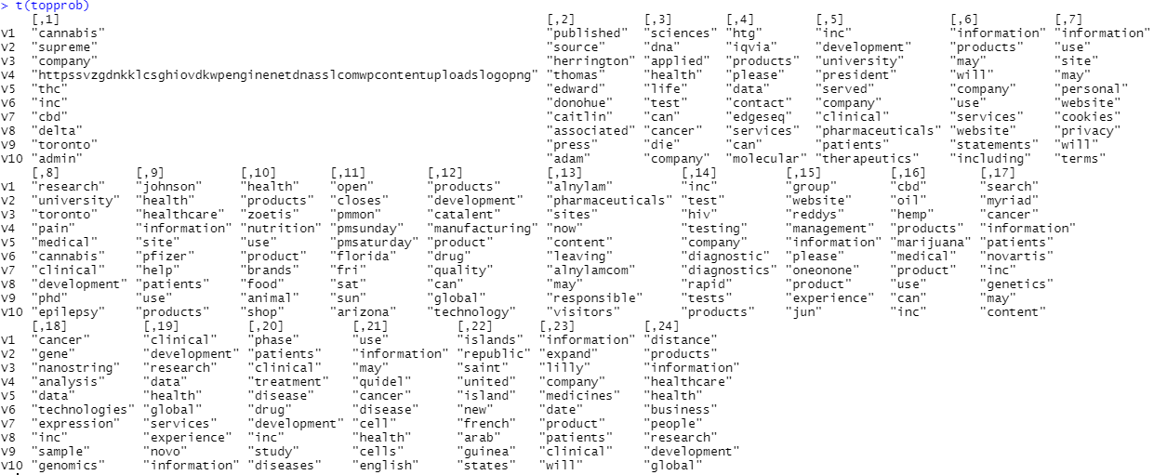
Rendering artifacts: Illustration
Many possible ways to illustrate the topics and documents.

Slide 32

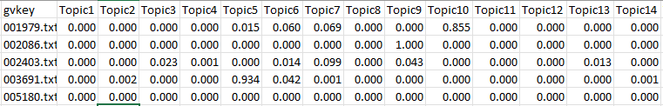

Slide 33
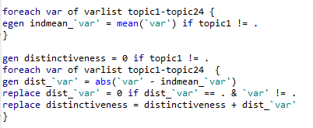
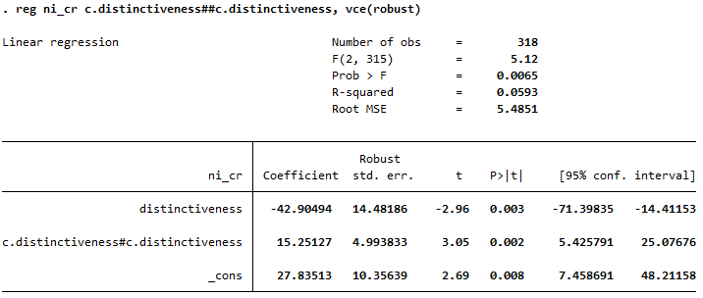

Slide 34


Slide 35
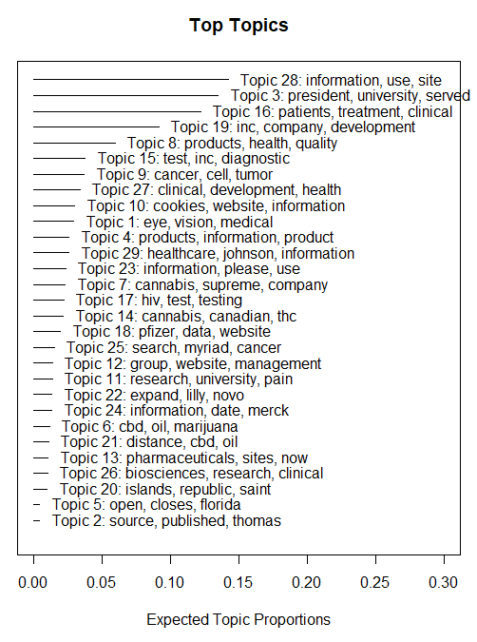
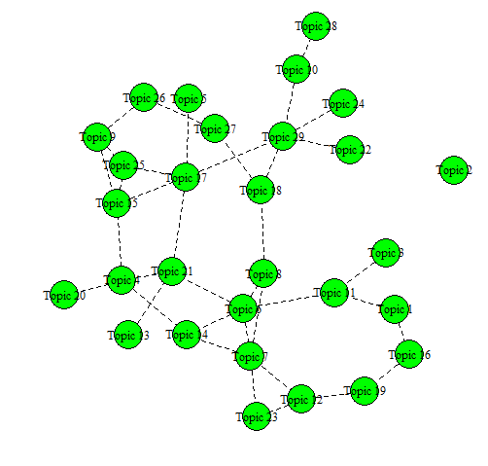
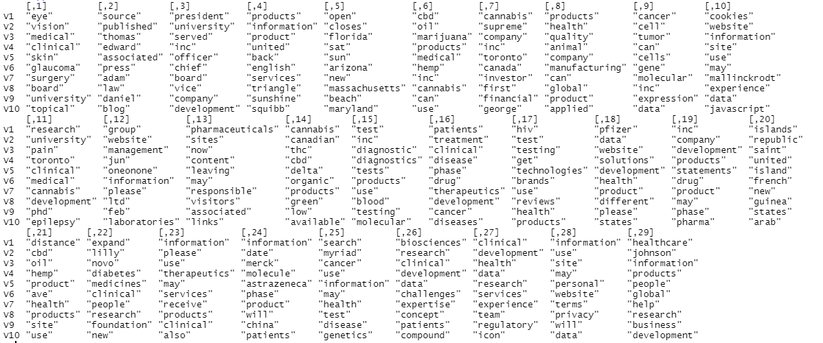

Slide 37
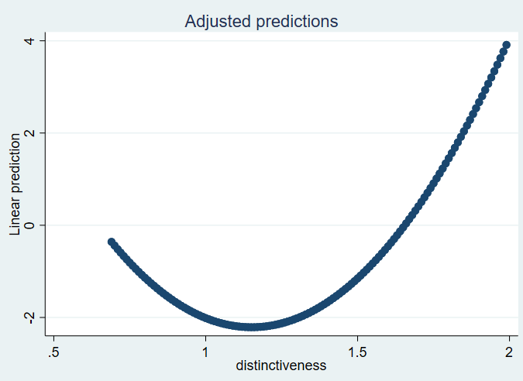
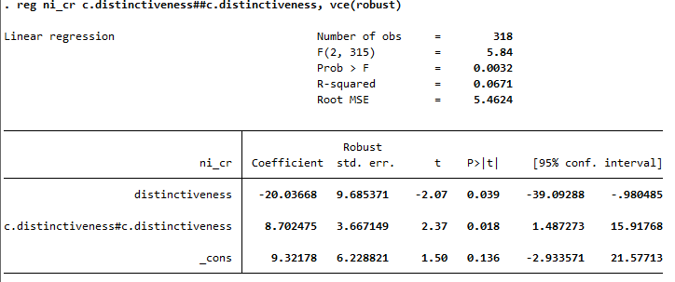

Slide 38
Thoughts on publishing w/ TMs

Slide 39
You have your results; then what?
Many editors and/or reviewers do not know much about topic modeling yet. There are few hard guidelines or rules of conduct as of yet.
Critical points to hit:
Explain the method briefly and clearly—more and more prior art to cite.
Justify the use of topic modeling (versus e.g. content analysis, word embedding models, deep reading...).
Be transparent about all choices made in the rendering process.
Validate, validate, validate.

Slide 40
Justification
Topic modeling works well for application where ...
you’re looking for latent topics inductively.
you have large amounts of texts.
subjective intervention of human coders is very costly / impossible.
It does not work as well:
For analyzing narratives, semantics, tone, style, things that rely on sequencing / grammar.
If you have a preset categorization in mind.
(Very) short texts.
The choice for topic modeling should come from the RQ, not because you have a hammer.

Slide 41
Reporting
Explain the data collection and cleaning process clearly:
Data source.
Sampling: which texts are excluded.
Which words were excluded.
How words were transformed / corrected / edited.
Explain how main parameters were selected:
Number of topics.
Model-specific parameters and options.
Show:
All identified topics and their top X terms (with term weights), perhaps in appendix. Distribution over corpus.
Representative document(s) or excerpt(s) for each topic.

Slide 42
Validation
Discuss:
Fit (fit statistics / prediction fitness).
Semantic validity (e.g. using expert validation).
Ask experts to verify that topics are meaningful and distinct.
Use expert coding/labeling and inter-coding reliability.
Use experts to flag garbage or chimera topics.
Evaluate documents assigned to topics.
Sensitivity:
Results / interpretations should be robust to small changes.
Changes should make sense.

Slide 43
In sum
Topic modeling offers a relatively easy to use toolkit to generate meaningful inductive, deductive, and abductive insights when analyzing textual data in strategy research.
But: its ease-of-use masks its complexities and sensitivity.
Critical reflection on its applicability, mindfulness of all its nuances, and careful validation are all a must if you want to publish using this method.
Usual best practices apply: document everything, ensure replicability and transparency, report clearly and comprehensively.
If done well, the sky is the limit.

Slide 44



Thanks!
Q&A
haans@rsm.nl
/richard-haans/
@RFJ_Haans

